Slide 1
P K TECHNICAL CAMPUS CHAKAN PUNE
DEPARTMENT OF COMPUTER ENGINEERING
BE Computer Engineering Dissertation Stage - II Presentation [2022-23]
Semester - 2

Slide 2
SMART SCHOOL ATTENDANCE USING NODE MCU AND FINGERPRINT SENSOR
Exam Seat No. | Name of Student
B191154210 B191154242 B191154246 B191154266 | Yashraj Chaudhari Harshal Patel Shriram Patil Viraj Vadhane
Guided By
Prof. S.R.Bhujbal

Slide 3
Introduction
Attendance monitoring is an indispensable part of any institute.
Monitoring of attendance helps increasing quality outcome, be it an educational institute.
The pen-paper based manual attendance system had too many fallacies and hard work. Moreover, it had a possibility of manipulation of the original data.
We have tried to make an automatic attendance system that would be to some extent free from some of the drawbacks of the pen-paper based attendance system.
The ID kit that has been used in this project, i.e. – ESP8266 Wifi module kit contains one ID and one wire assembly . The card can be used as an employee ID card or student ID card. The ID is weared by the student.

Slide 4
Problem Statement
To build website for smart attendance system.
Marking auto attendance using Wifi Module and smart ID Card.
Learning wireless connectivity and record management.

Slide 5
Future Scope
Wireless attendance management by decreasing the human effort.
Easy to handle records for staff and user security is provided.

Slide 6
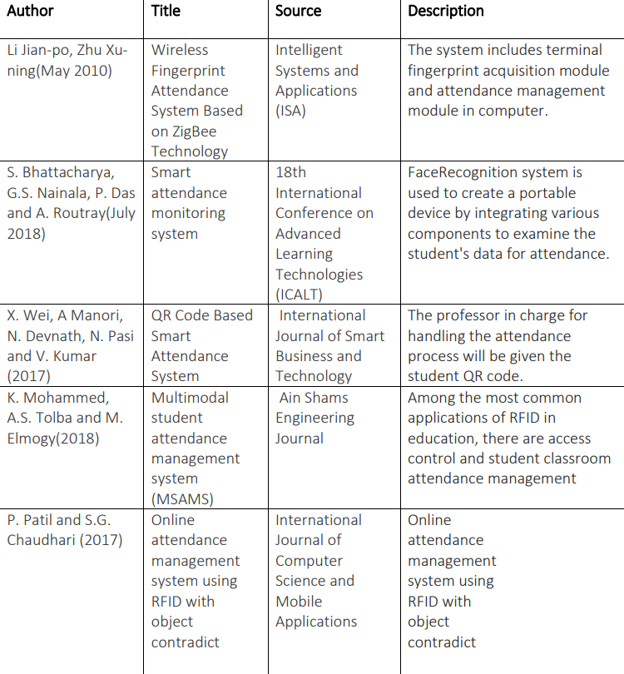
Literature Survey

Slide 7
Requirement Analysis
Software Requirements
Hardware Requirements
Arduino IDE
RAM: 2GB or higher
Processor: intel i5 or higher
Visual Studio Code
Java Runtime Environment.
Eclipse
Bread Board
ESP8266 wifi module
Finger-Print Sensor
OLED Display
500 mAh Battery

Slide 8
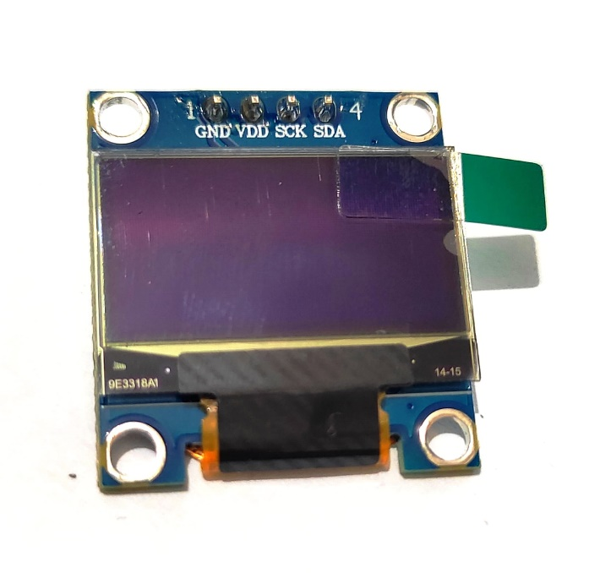
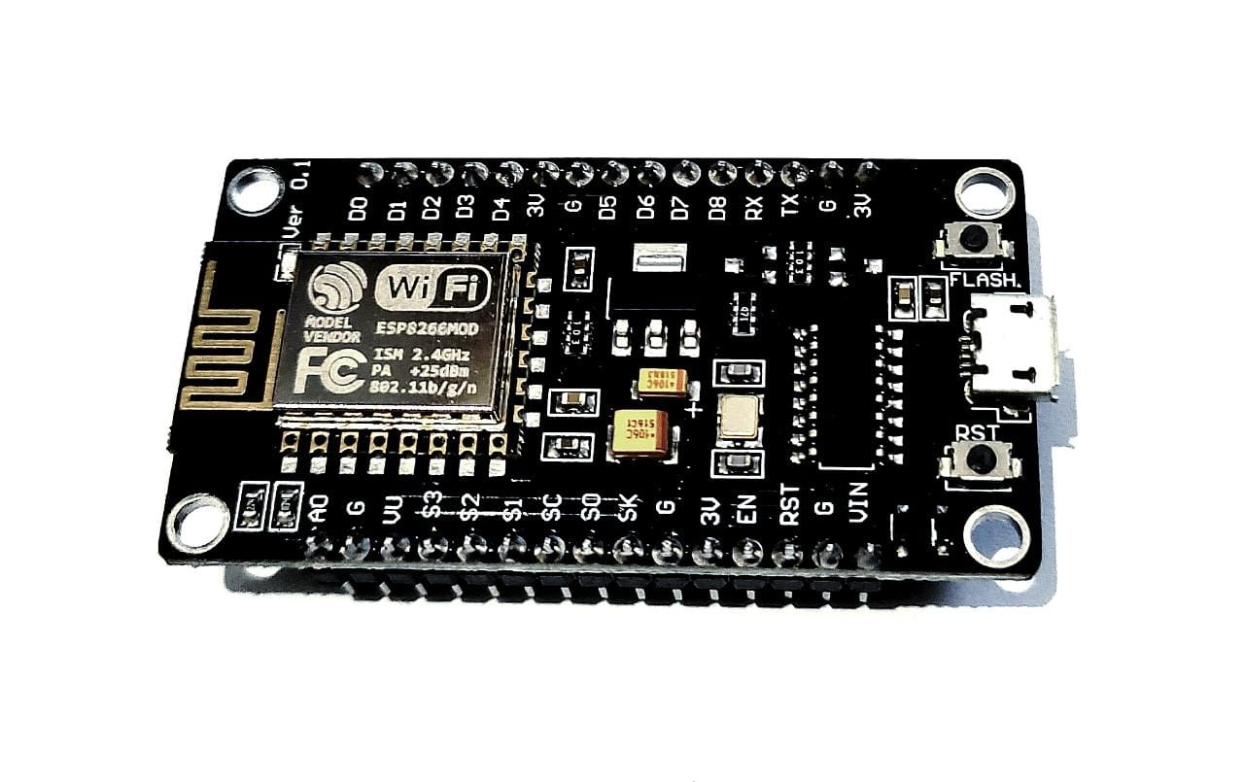
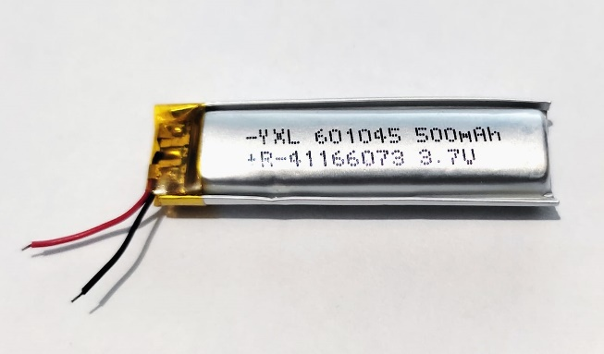
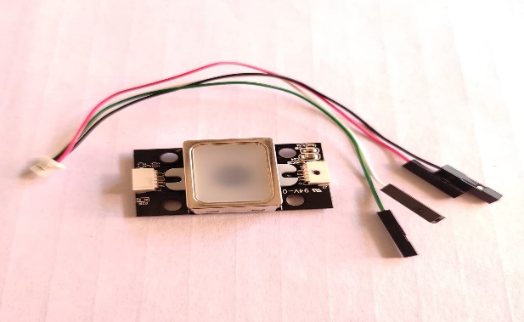
Hardware
Fig-1. ESP8266 Wifi Module
Fig-2. OLED Display
Fig-3. Battery
Fig-4.Fingerprint Sensor

Slide 9
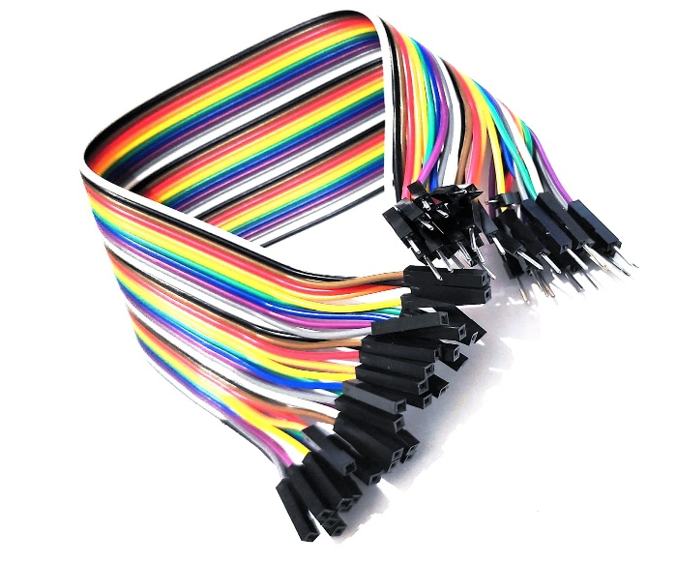
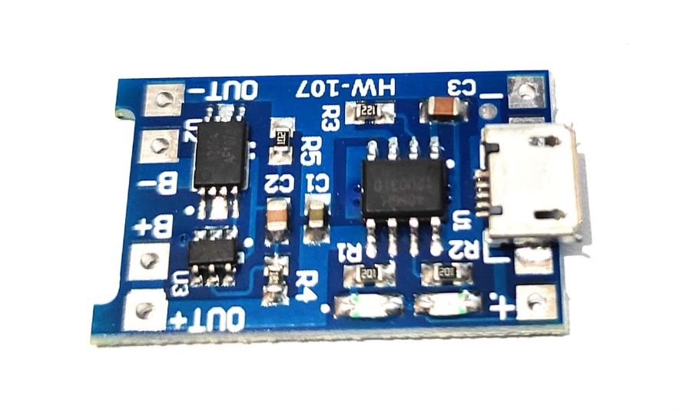
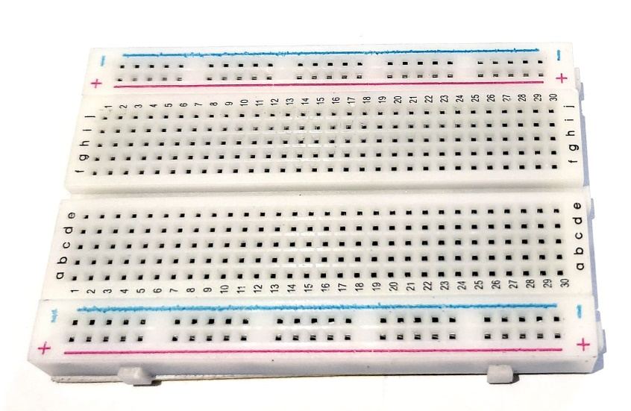
Fig 5-TP4056 Charging Module
Fig-6 Jumper Wires
Fig 7- Bread Board

Slide 10
Proposed System
The Proposed system of Smart attendance system using ESP8266. The architecture is centered on mini computer which act as a main controller of the system.
Initially an ESP8266 module is provided to each student, it act like a smart card which is already connected to the Wi-Fi router and it is provided with an unique IP address.
In this process, required information of Student name, Student unique IP address, Student Register number are recorded in the local host of the main server.
The same information is feed into the ESP8266 module for smart attendance system.

Slide 11
Fig 7. Flow chart for Smart Attendance System

Slide 12
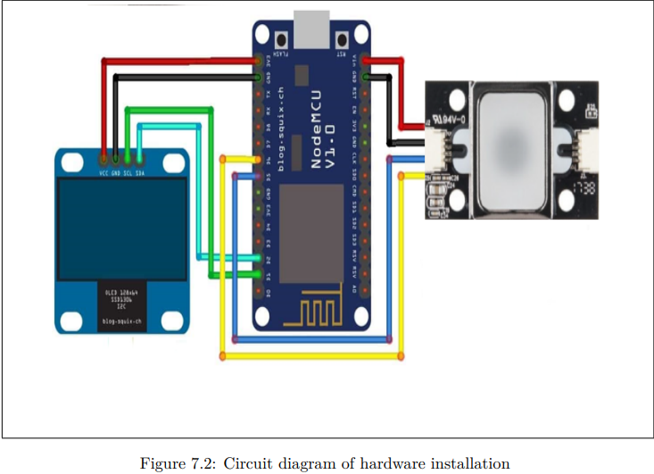
Working of the System

Slide 13
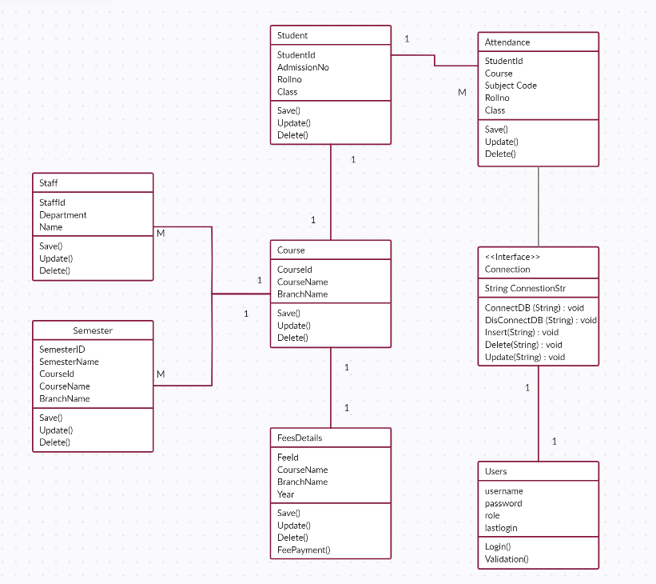
System Design

Slide 14
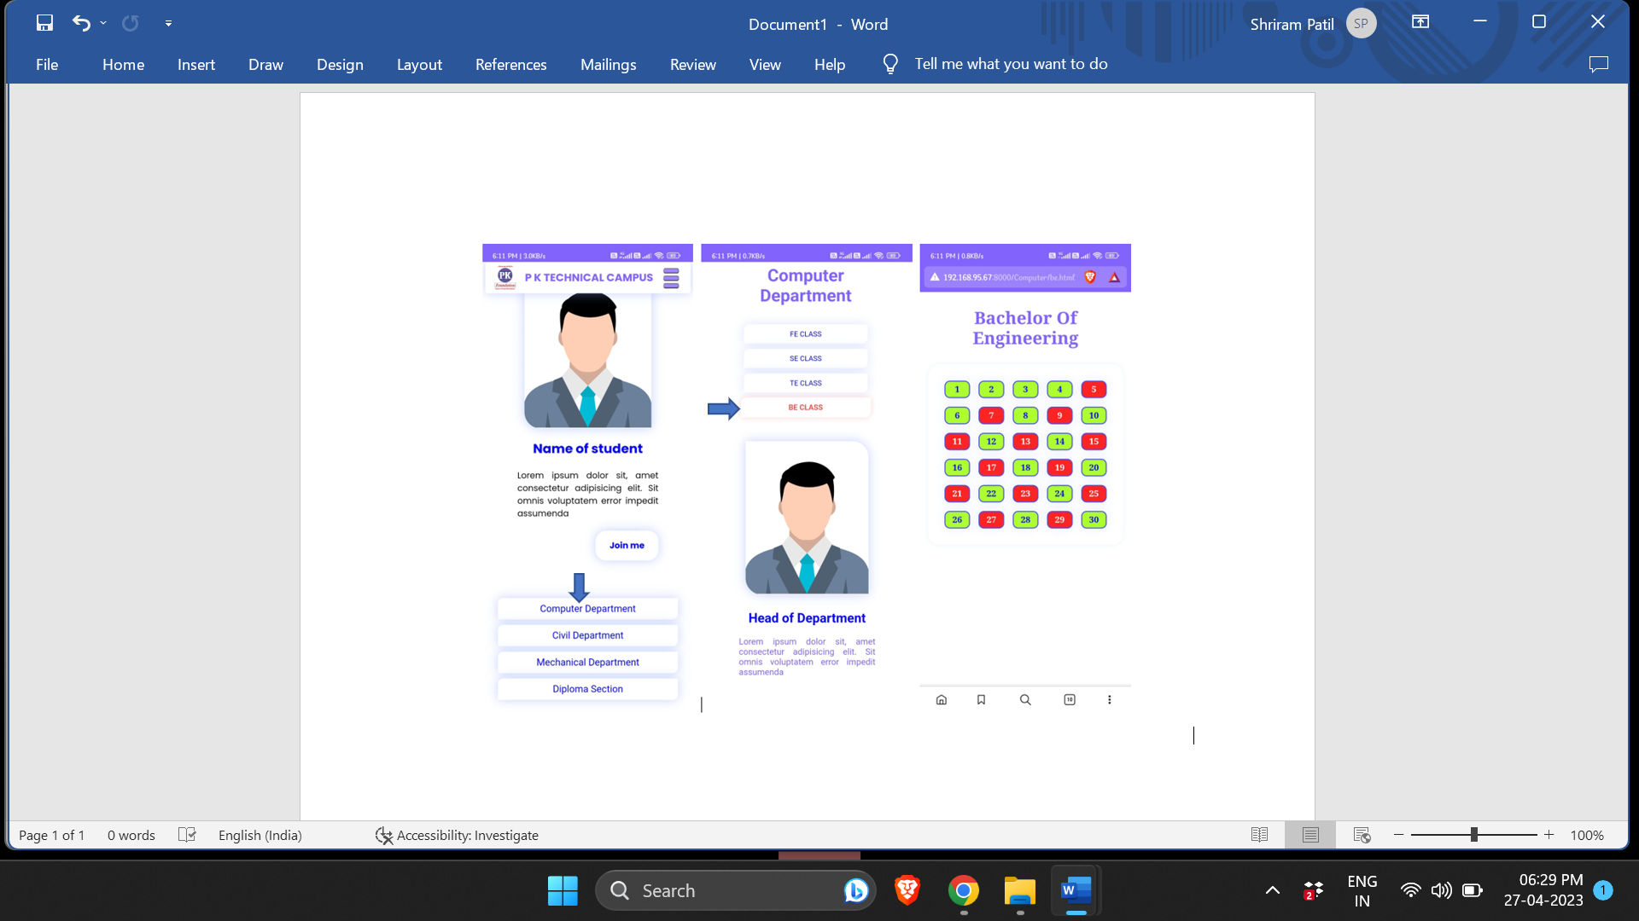
Website

Slide 15
References
[1] BABAK MALEKI SHOJA AND NASSEH TABRIZI, “Customer Reviews Analysis With Deep Neural Networks for E-Commerce Recommender Systems," IEEE, Digital Object Identifier 2019.
[2] M. Darabi and N. Tabrizi, “An ontology-based framework to model user interests," in Proc. Int. Conf. Comput. Sci. Comput. Intell. (CSCI), Dec. 2016, pp. 398403.
[3]M. M. Susan and S. David, “What makes a helpful review? A study of customer reviews on Amazon.com,“ MIS Quart., vol. 34, no. 1, pp. 185200, 2010.
[4] E. Baralis, L. Cagliero, T. Cerquitelli, S. Chiusano, P. Garza, D. Antonelli, G. Bruno, and N. A. Mahoto, “Personalized tag recommendation based on generalized rules," ACM Trans. Intell. Syst. Technol., 2019.

Slide 16
THANK YOU!

